Slide 1
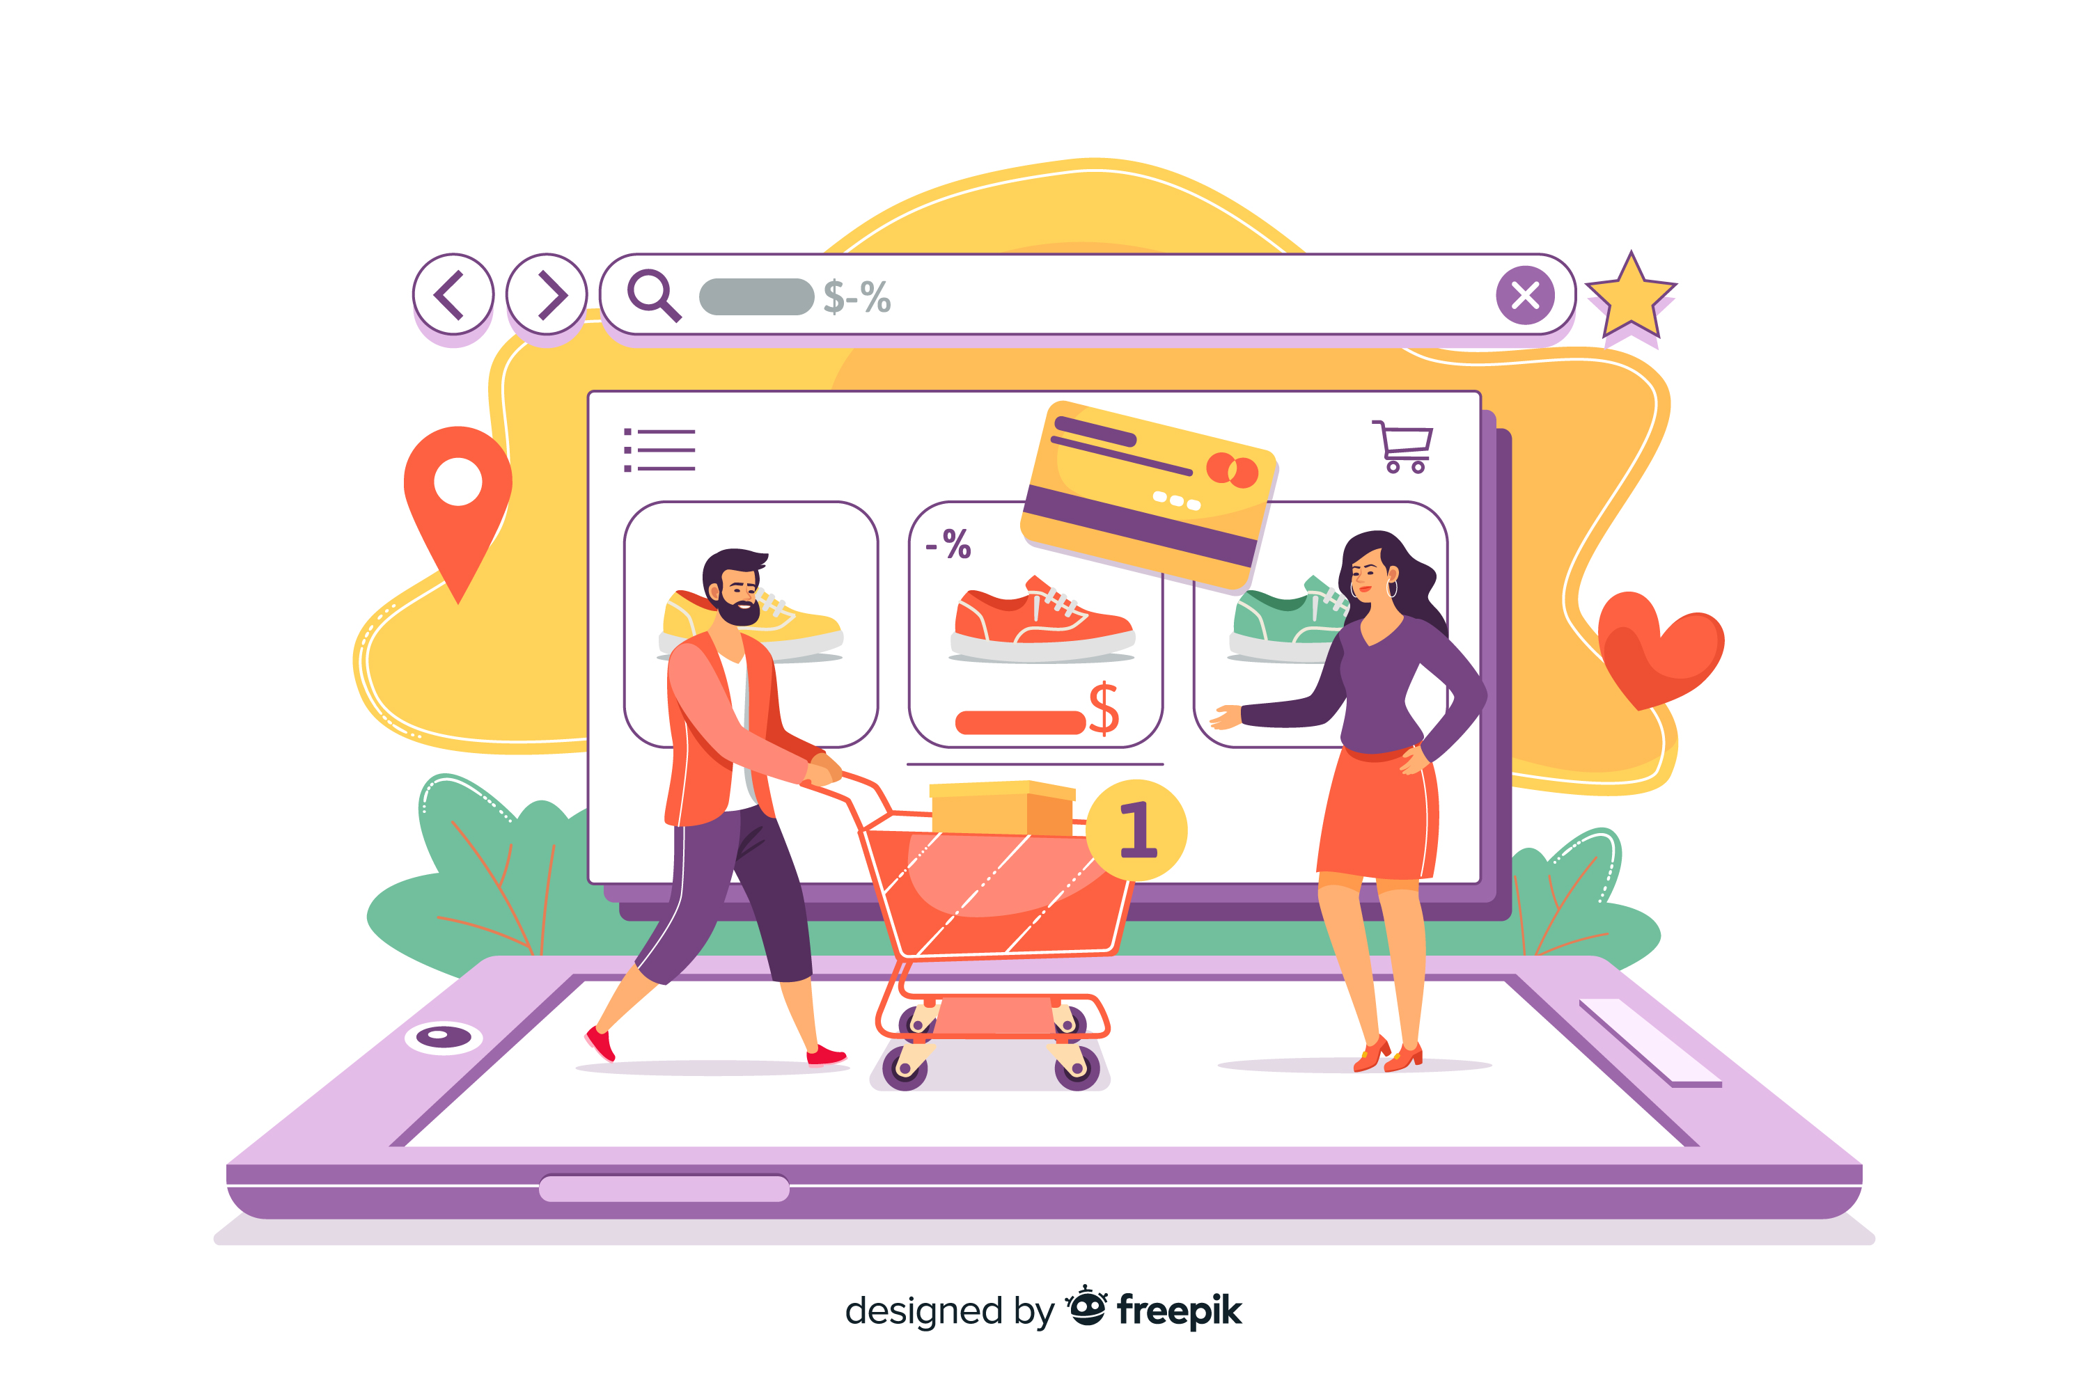
Online Retail Analysis
Online Retail Analysis

Slide 2
Online Retail
Introduction:
An online retail store is a digital platform where customers can browse and purchase products over the internet. It enables businesses to track sales, customer behavior, and product performance. This data helps drive decisions on marketing, inventory, and expansion strategies.
Introduction
About:
Online retail has become one of the leading trends in the current generation. It serves as a valuable aid for elderly and sick individuals who may find it difficult to visit physical stores to find quality products at affordable prices. Beyond this, it also benefits the general population, as many choose online shopping for the convenience and competitive pricing.
There are several ways to increase revenue in online retail, including improving profit margins, launching innovative marketing strategies to boost customer purchase behavior, and expanding into international markets. However, profit margins have their limitations, and marketing efforts can eventually reach a point of saturation.
Expanding into new regions or improving sales in underperforming areas presents a promising opportunity for revenue growth. However, it's crucial to account for the varying rules, regulations, and tax structures across different countries, as these factors can significantly influence profit margins and overall revenue.
Dashboard
Countries
Sales Trend
Products
Customers
Key Insights
Conclusion

Slide 3

Online Retail
Introduction
Dashboard
Countries
Sales Trend
Products
Customers
Key Insights
Conclusion

Slide 4
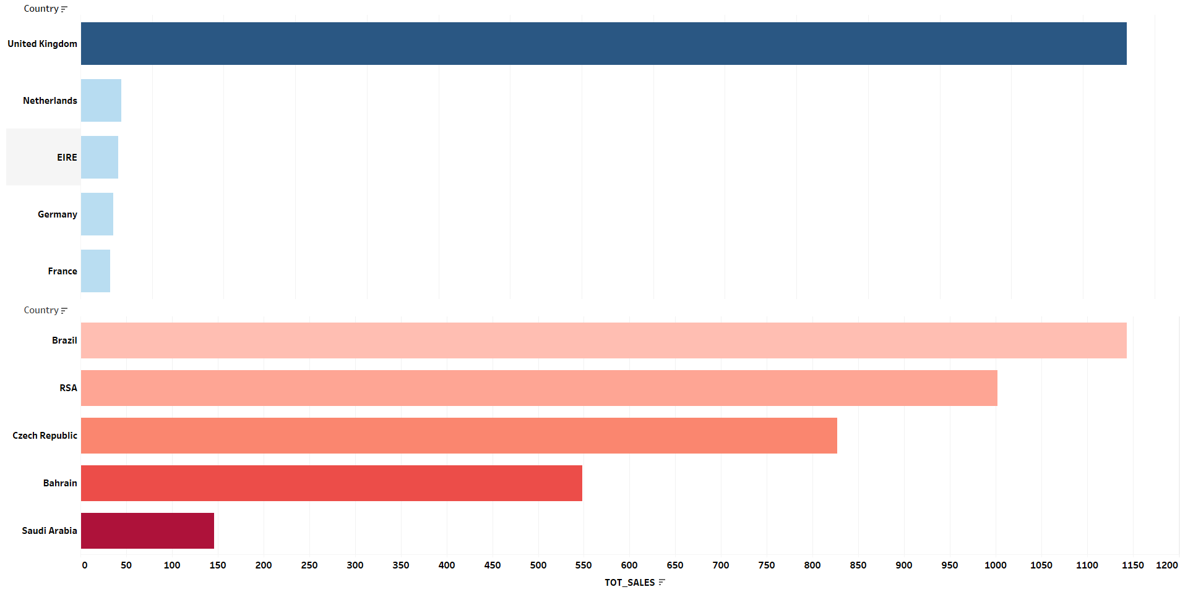
Online Retail
Which country generates the highest revenue?
Introduction
Dashboard
Countries
Sales Trend
Products
Customers
Key Insights
Conclusion
The United Kingdom generates the highest revenue among all countries, with its sales trend showing consistent growth over time. Following the UK, the Netherlands, Ireland (ERIE), Germany, and France also contribute significantly to overall revenue.
1
2

Slide 5
Online Retail
Which country generates the low revenue?
Introduction
Dashboard
Countries
Sales Trend
Products
Customers
Key Insights
Conclusion
Saudi Arabia and Bahrain are among the countries that generate the lowest revenue.
1
2

Slide 6
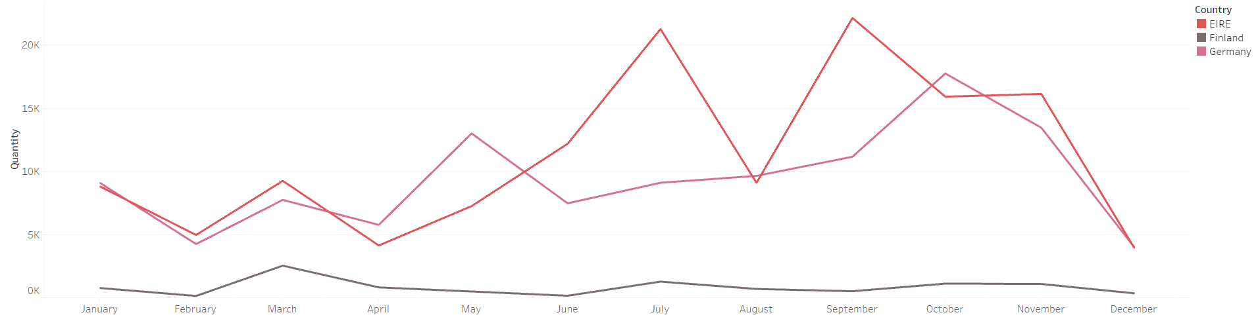
Online Retail
Have sales trends in the top countries increased over time?
Introduction
Dashboard
Countries
Sales Trend
Products
Customers
Key Insights
Conclusion
Excluding the United Kingdom, countries like EIRE, Finland, and Germany experienced fluctuating sales trends throughout 2011, with a gradual decline toward the end of the year. The peaks in sales may have been driven by specific needs during certain periods.
1
2

Slide 7
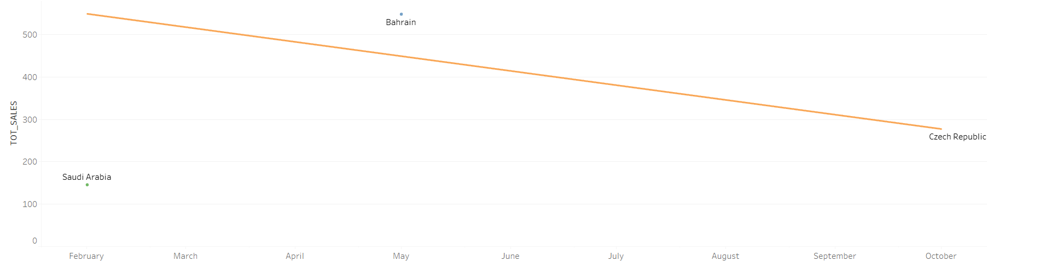
Online Retail
Have sales trends in the top countries increased over time?
Introduction
Dashboard
Countries
Sales Trend
Products
Customers
Key Insights
Conclusion
Bahrain and Saudi Arabia display a distinct pattern on the graph, showing only isolated data points instead of a continuous sales line. This indicates that these countries placed orders only once during the past year, with an average customer count of just one.
1
2

Slide 8
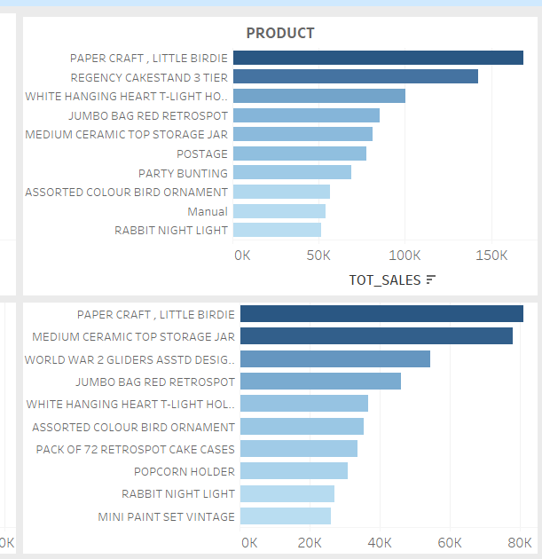
Online Retail
Which product is most frequently purchased by the top customer?
Paper Craft – Little Birdie stands out as the top-selling product among all others. Based on the graph, if we group products under an informal category, many of the best-sellers appear to be party-related items—such as rabbit night lights, cake stands, and paper crafts.
By analyzing peaks in sales trends and correlating them with regional festivals or party seasons, we can identify key periods of high demand. This insight can be used to boost sales by focusing on trending products, strategically placing advertisement banners for top-selling items, and aligning marketing efforts with seasonal or regional events.
Introduction
Dashboard
Countries
Sales Trend
Products
Customers
Key Insights
Conclusion
1
2

Slide 9
Online Retail
Which product is most frequently purchased by the top customer?
Introduction
Dashboard
Countries
Restock frequently at region-specific peak demand periods.
Sales Trend
Products
Customers
Key Insights
Conclusion
1
2

Slide 10
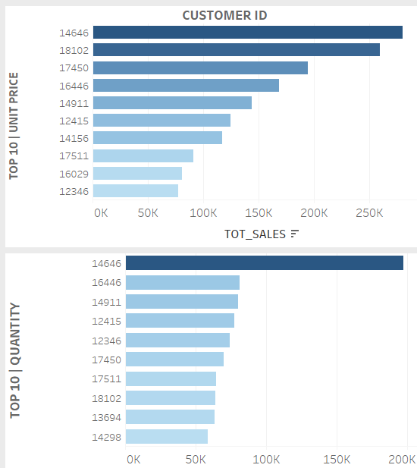
Online Retail
Introduction
Which customer has made purchases across the most countries?
Customer ID 14646 has made purchases across the most countries, contributing the highest quantity of products sold and a significant share of the overall revenue. Following this customer, other top buyers vary depending on the quantity purchased and the unit price of the products.
Dashboard
Countries
Sales Trend
Products
Customers
Key Insights
Conclusion
1
2

Slide 11
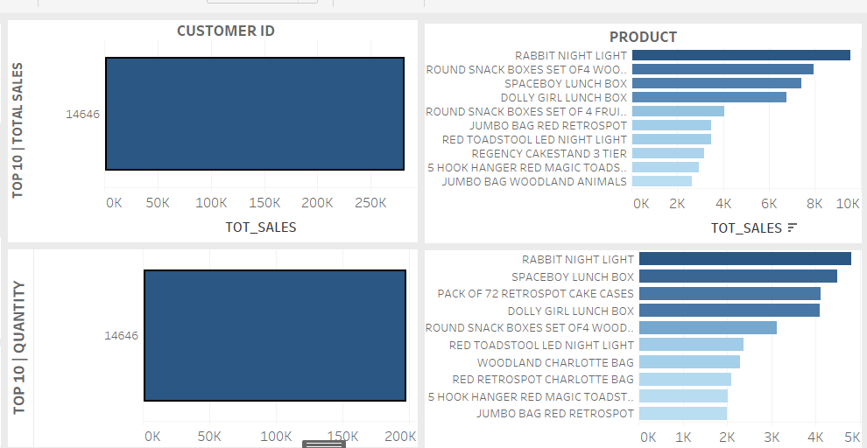
Online Retail
Which product is most frequently purchased by the top customer?
Introduction
Dashboard
Countries
Sales Trend
Products
Customers
Key Insights
Conclusion
Rabbit Night Light and Space Lunchbox are the most purchased products by customer ID 14646. It appears that this customer buys these products for resale to local buyers. Offering discounts on bulk purchases or providing special coupons can help retain such high-volume customers and encourage them to continue buying from our company.
1
2
2

Slide 12
Online Retail
Key insights:
Customers who purchase large quantities are likely local shop owners, while those buying smaller quantities tend to be general consumers.
Sales declined towards the end of the previous year. However, sales in the UK have remained stable, and forecasts indicate improvement in the next quarter.
In contrast, countries such as EIRE, the Netherlands, and Germany have experienced a decline in customer purchases.
Since party-related products are among the best sellers, analyzing regional festival trends can help boost product sales by aligning inventory and marketing efforts with these events.
To retain high-value customers, offering targeted discounts or coupons can be effective.
Ensuring high-quality delivery is crucial, as damaged or missing products can negatively impact customer trust and the reputation of the retail site.
Additionally, providing offers during special occasions—while keeping an eye on profit margins—can help increase the site’s market presence through positive word of mouth.
Introduction
Dashboard
Countries
Sales Trend
Products
Customers
Key Insights
Conclusion

Slide 13
Online Retail
Conclusion:
Online retail is a vast business that must prioritize customer satisfaction while also considering profitability. Even with lower profit margins, entering new markets can be beneficial until saturation is reached. Advertising methods such as banners, ads, and marketing campaigns play a key role in influencing customers and generating word-of-mouth promotion.
Maintaining a low profit margin can help expand the market, and any monthly revenue loss can be offset by higher sales volumes during festivals. This strategy also helps increase brand recognition among consumers.
Additionally, low-scale production tends to be more expensive due to higher per-unit costs, whereas bulk production at a larger scale reduces costs significantly.
Introduction
Dashboard
Countries
Sales Trend
Products
Customers
Key Insights
Conclusion

Slide 14
Thank You

